Slide 1
Hypothesis Testing Process
Parametric tests
Week 8

Slide 2
Recap
In Week 7
  Basic concepts of statistical analysis
  Preparing data for analysis
  Descriptive statistics
    Measures of central tendency
    Measures of variability
  Graphs
This week
  Inferential statistics
  Comparing means
  Hypothesis testing process
  Types of Hypothesis
  Parametric Tests t-Tests, z-Tests

Slide 3

Basic concepts of inferential statistics

Slide 4
Frequency distribution

Slide 5
Frequency distribution
The frequency of a value is the number of times it occurs in a dataset.
A frequency distribution is the pattern of frequencies of a variable.
It’s the number of times each possible value of a variable occurs in a dataset.

Slide 6
Frequency table
Frequency distributions are often displayed using frequency tables. A frequency table is an effective way to summarize or organize a dataset. It’s usually composed of two columns:
  The values or class intervals
  Their frequencies
Error Type | Frequency
High | 5
Medium | 8
Low | 18
Trivial | 25

Slide 7
Types of frequency distributions
Ungrouped frequency distributions – the number of observations of each value of a variable (categorical variables).
Grouped frequency distributions – the number of observations of each class interval of a variable (ordered groupings of a variable’s values for quantitative variables).
Relative frequency distributions – the proportion of observations of each value or class interval of a variable (any type of variable when comparing frequencies than the actual number of observations).
Cumulative frequency distributions – the sum of the frequencies less than or equal to each value or class interval of a variable (for ordinal or quantitative variables when you want to understand how often observations fall below certain values).
Task completion:
10-19 seconds: 4 occurrences
20-29 seconds: 4 occurrences
30-39 seconds: 2 occurrences
40-49 seconds: 0 occurrences
The "Save" button was clicked 500 times.
The total number of interactions (clicks, swipes, etc.) across the app during this period was 10,000.
Relative Frequency = (Number of "Save" button clicks / Total number of interactions) * 100
Relative Frequency = (500 / 10,000) * 100 = 5%
Cumulative frequency:
Day 1: 10 successful purchases
Day 2: 15 successful purchases
Day 3: 8 successful purchases
Day 4: 12 successful purchases
Day 1: 10 (cumulative)
Day 2: 10 (previous cumulative) + 15 = 25
Day 3: 25 (previous cumulative) + 8 = 33
Day 4: 33 (previous cumulative) + 12 = 45
Notes:
Grouped frequency in UX context typically involves categorizing data into ranges or groups and then determining how many occurrences fall within each group. This can be useful when analyzing quantitative data, such as response times, task completion durations, or other numerical metrics. Here's an example:
Suppose you are conducting usability testing on a website, and you want to analyze the time it takes for users to complete a specific task. You collect data on the task completion times for a sample of users:
User 1: 15 seconds
User 2: 22 seconds
User 3: 18 seconds
User 4: 35 seconds
User 5: 27 seconds
User 6: 40 seconds
User 7: 20 seconds
User 8: 32 seconds
User 9: 25 seconds
User 10: 38 seconds
Now, you can group these completion times into ranges (bins) to create a grouped frequency distribution. For this example, let's use bins of 10 seconds each:
10-19 seconds: 4 occurrences
20-29 seconds: 4 occurrences
30-39 seconds: 2 occurrences
40-49 seconds: 0 occurrences
In this grouped frequency distribution:
Four users completed the task in the 10-19 second range.
Four users completed the task in the 20-29 second range.
Two users completed the task in the 30-39 second range.
No users completed the task in the 40-49 second range.
This grouped frequency information can provide insights into the distribution of task completion times. UX designers can use this data to identify common patterns, outliers, or potential usability issues related to task efficiency. For instance, if a significant number of users are consistently taking longer to complete the task, it may indicate an area for improvement in the user interface or workflow.
In the context of user experience (UX), relative frequency refers to the proportion or percentage of occurrences of a specific user behavior or interaction relative to the total number of interactions or sessions.
Let's consider an example:
Imagine you have a mobile app, and you're interested in understanding how frequently users engage with a particular feature, let's say a "Save" button. You collect data over a month, and during this time, users performed various interactions with your app.
The "Save" button was clicked 500 times.
The total number of interactions (clicks, swipes, etc.) across the app during this period was 10,000.
To calculate the relative frequency of the "Save" button clicks:
Relative Frequency = (Number of "Save" button clicks / Total number of interactions) * 100
Relative Frequency = (500 / 10,000) * 100 = 5%
So, in this example, the relative frequency of users clicking the "Save" button is 5%. This information can be valuable for UX designers and product managers to assess the importance of the "Save" feature and make informed decisions about its placement, design, or potential improvements based on user engagement patterns.
In UX research and analysis, cumulative frequency can be used to understand the distribution of a particular user behavior or interaction over time. Let's consider an example:
Imagine you're tracking the number of user sessions where users successfully complete a purchase on your e-commerce website. You collect data over a month, and you want to analyze how the cumulative frequency of successful purchases evolves.
Here's a simplified dataset:
Day 1: 10 successful purchases
Day 2: 15 successful purchases
Day 3: 8 successful purchases
Day 4: 12 successful purchases
To calculate the cumulative frequency:
Day 1: 10 (cumulative)
Day 2: 10 (previous cumulative) + 15 = 25
Day 3: 25 (previous cumulative) + 8 = 33
Day 4: 33 (previous cumulative) + 12 = 45
So, the cumulative frequency of successful purchases after each day would be:
Day 1: 10
Day 2: 25
Day 3: 33
Day 4: 45
This information helps you understand how the total number of successful purchases accumulates over time. In the context of UX, you might use this data to identify trends, patterns, or potential issues. For instance, if the cumulative frequency of successful purchases is not increasing as expected, it could indicate a usability problem or a barrier in the user journey that needs attention.

Slide 8
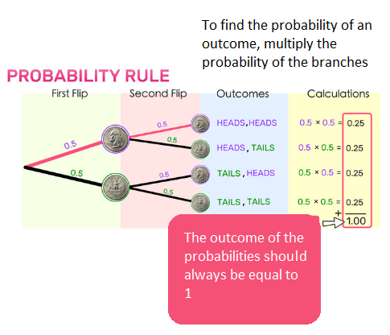
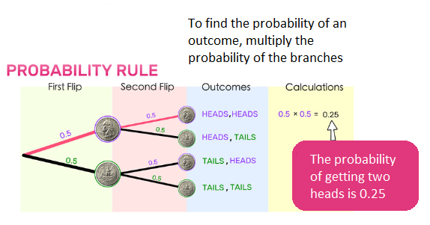
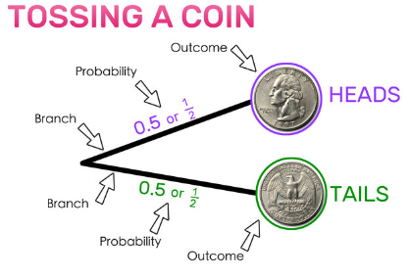
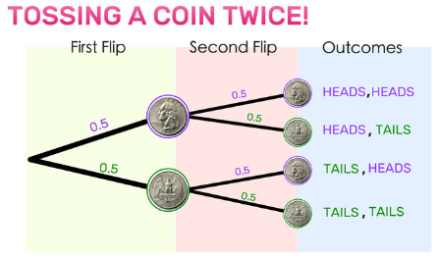
Probability

Slide 9
Probability distribution
A probability distribution is a mathematical function that describes the probability of different possible values of a variable.
A probability distribution is an idealised frequency distribution.
A frequency distribution describes a specific sample or dataset. It’s the number of times each possible value of a variable occurs in the dataset.

Slide 10
Probability distribution
Probability is a number between 0 and 1 that says how likely something is to occur:
  0 means it’s impossible.
  1 means it’s certain.
The higher the frequency of a value in a sample the higher its probability. More specifically, the probability of a value is its relative frequency in an infinitely large sample.
Infinitely large samples are impossible in real life, so probability distributions are theoretical. They’re idealised versions of frequency distributions that aim to describe the population the sample was drawn from.
Probability distributions are used to describe the populations of real-life variables, like coin tosses or the weight of chicken eggs. They’re also used in hypothesis testing to determine the p-value.

Slide 11
p-value
A p-value is a statistical measurement used to validate a hypothesis against observed data.
A p-value measures the probability of obtaining the observed results, assuming that the null hypothesis is true.
We will examine the p-value later

Slide 12
Types of probability distributions
Discrete probability distributions is distributions of a categorical or discrete variable
  No possibility for 0 (dice rolls)
Continuous probability distribution is the probability distribution of a continuous variable
  A continuous variable can have any value between its lowest and highest values. Therefore, continuous probability distributions include every number in the variable’s range.

Slide 13
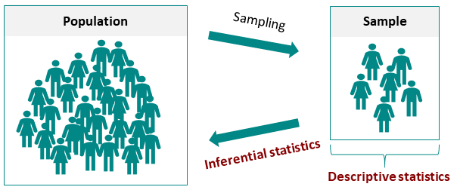
Inferential statistics
Notes:
Descriptive statistics and inferential statistics are the two main areas of statistics. Descriptive statistics provides tools to describe a sample. Starting from the sample, inferential statistics can now be used to make a statement about the population.

Slide 14
Inferential statistics
While descriptive statistics can only summarize a sample’s characteristics, inferential statistics use the sample to make reasonable guesses about the larger population.
Inferential statistics have two main uses:
  making estimates about populations
  testing hypotheses to draw conclusions about populations

Slide 15
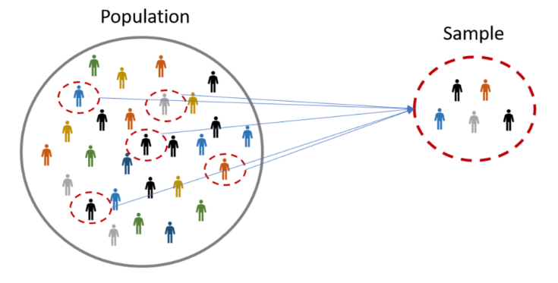
Importance of sample
Since the size of a sample is always smaller than the size of the population, some of the population isn’t captured by sample data. This creates sampling error, which is the difference between the true population values and the measured sample values.
Sample size is a part of the population chosen for a survey or experiment

Slide 16
Estimating population parameters from sample statistics
The characteristics of samples and populations are described by numbers called statistics and parameters:
  A statistic is a measure that describes the sample (e.g., sample mean).
  A parameter is a measure that describes the whole population (e.g., population mean).
Sampling error is the difference between a sample statistic and the true population parameter it represents. Since in most cases you don’t know the real population parameter, you can use inferential statistics to estimate these parameters in a way that takes sampling error into account.
Notes:
Sampling error is the difference between a sample statistic and the true population parameter it represents. It occurs because we collect data from a subset of the population (the sample) rather than from the entire population. Since a sample is only a portion of the population, the characteristics of the sample may not perfectly reflect the characteristics of the entire population.
There are various sources of sampling error, including:
Random Sampling Variability: In a truly random sample, each member of the population has an equal chance of being included. Due to this random variability, different samples from the same population may yield different results.
Sampling Bias: If the sample is not representative of the population, meaning it doesn't accurately reflect the characteristics of the entire population, sampling bias can occur. This can lead to systematic errors in the sample results.
Undercoverage: When certain groups in the population are not included or are underrepresented in the sample, the sample may not accurately represent the entire population.
Non-response Bias: If a subset of the selected sample does not respond to the survey or study, their absence can introduce bias if they differ systematically from those who do respond.
Reducing sampling error involves using appropriate sampling methods, ensuring randomness, and minimizing biases. It's important for researchers and statisticians to be aware of the potential sources of error and to report the margin of error when presenting findings based on samples. The margin of error is a measure of the sampling error and is often reported as a range around the estimated parameter.

Slide 17
Confidence intervals & confidence levels
A confidence interval is a range of values that gives an estimate of where a population parameter (like a mean or proportion) is likely to fall, based on sample data. It provides a way to understand the uncertainty in our estimate.
For example, if you survey a sample of people and find that the average time they spend on a task is 5 minutes, a confidence interval might tell you that you’re 95% confident the true average time for everyone in the population is somewhere between 4.5 and 5.5 minutes.
Confidence intervals are useful for estimating parameters because they take sampling error into account.
Each confidence interval is associated with a confidence level. A confidence level tells you the probability (in percentage) of the interval containing the parameter estimate if you repeat the study again.
A 95% confidence interval means that if you repeat your study with a new sample in exactly the same way 100 times, you can expect your estimate to lie within the specified range of values 95 times.
Random sampling and suitable sample size, can ensure that the confidence interval contains the parameter a certain percentage of the time.

Slide 18
In simple terms:
The center of the confidence interval is the sample’s estimate (like the sample mean).
The width of the interval reflects how much uncertainty there is, influenced by the sample size and variability.
A 95% confidence level means that if you repeated the study many times, 95% of the calculated intervals would contain the true population parameter.

Slide 19
Sample size depends on
Nature of the Study
  Usability Testing: For qualitative usability testing, 5–10 participants per group are often sufficient to identify the majority of usability issues, as these tests are usually aimed at finding patterns rather than statistical significance.
  Quantitative Studies: For studies that require statistical analysis (e.g., comparing groups, correlations), a larger sample size is necessary to achieve reliable results.
Effect Size and Statistical Power
  Effect Size: This is a measure of how strong the relationship is between variables. If you expect a small effect size, a larger sample size is required to detect it, whereas a larger effect size can be detected with fewer participants.
  Statistical Power: To achieve a standard power level of 0.80 (80%), which means an 80% chance of detecting an effect if it exists, sample size requirements vary depending on the analysis method and effect size. Example: For a medium effect size (Cohen's d = 0.5) in a t-test, about 30 participants per group are generally recommended for adequate power.
Research Design
  Between-Subjects Design: This design compares different groups, so each group needs an adequate sample size (e.g., 30–50 participants per group for quantitative studies).
  Within-Subjects Design: Fewer participants are typically needed, as each participant serves as their own control, so variability is reduced.
Confidence Level and Margin of Error
  Confidence Level: A higher confidence level (e.g., 95% or 99%) requires a larger sample size to ensure precision.
  Margin of Error: A smaller margin of error (e.g., ±5%) requires a larger sample size. For example, in survey research, about 385 participants are typically needed for a 5% margin of error at a 95% confidence level for a large population.

Slide 20
Sample size summary
General Guidelines by Study Type
  Usability Testing (Qualitative): 5–10 participants per group.
  A/B Testing (Quantitative): At least 30–50 participants per group for statistical significance, but larger samples are ideal.
  Survey Research: Around 385 participants for a large population, aiming for a 5% margin of error and a 95% confidence level.
  Experimental Research (Quantitative): Typically 15–30 participants per condition for initial studies, and ideally 50+ per condition for more reliable results.
  Using Sample Size Calculators - Tools such as G*Power, Raosoft, or online sample size calculators can help determine the sample size based on desired power, effect size, and confidence level.

Slide 21
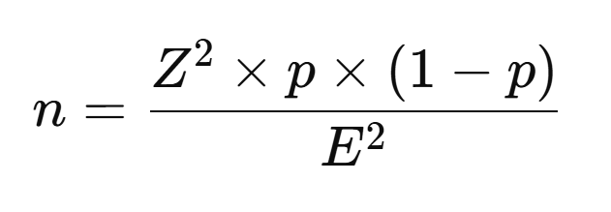
Sample size for proportion (binary data)
If you're calculating the sample size for a proportion (e.g., the percentage of users who are satisfied with a product):
1. Identify the Desired Confidence Level
  Common confidence levels are 90%, 95%, and 99%. A higher confidence level increases the required sample size because it demands a more precise estimate.
  Z-score values correspond to confidence levels:
  90% confidence level: Z = 1.645
  95% confidence level: Z = 1.96
  99% confidence level: Z = 2.576
2. Define the Margin of Error (E)
  The margin of error represents the maximum allowable difference between the sample estimate and the true population parameter.
  A smaller margin of error requires a larger sample size for greater precision.
3. Estimate the Population Variability
  For continuous data, use the estimated standard deviation (σ) based on previous studies or a pilot study.
  For proportions (e.g., in surveys), use p = 0.5 if no prior information is available, as it provides the maximum variability and thus the largest sample size.
4. Calculate the Sample Size
  Use the following formulas based on data type:For a Proportion (Binary Data)If you're calculating the sample size for a proportion (e.g., the percentage of users who are satisfied with a product):
Where:
n = required sample size
Z = Z-score corresponding to the confidence level (e.g., 1.96 for 95% confidence)
p = estimated proportion (use 0.5 if unknown, for maximum variability)
E = margin of error

Slide 22
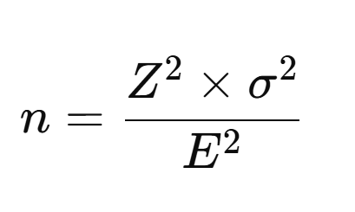
Sample size for Continuous Variable (Mean with Standard Deviation)
If you’re calculating the sample size for a continuous variable (e.g., task completion time):
1. Identify the Desired Confidence Level
  Common confidence levels are 90%, 95%, and 99%. A higher confidence level increases the required sample size because it demands a more precise estimate.
  Z-score values correspond to confidence levels:
  90% confidence level: Z = 1.645
  95% confidence level: Z = 1.96
  99% confidence level: Z = 2.576
2. Define the Margin of Error (E)
  The margin of error represents the maximum allowable difference between the sample estimate and the true population parameter.
  A smaller margin of error requires a larger sample size for greater precision.
3. Estimate the Population Variability
  For continuous data, use the estimated standard deviation (σ) based on previous studies or a pilot study.
  For proportions (e.g., in surveys), use p = 0.5 if no prior information is available, as it provides the maximum variability and thus the largest sample size.
4. Calculate the Sample Size
  Use the following formulas based on data type:For a Proportion (Binary Data)If you're calculating the sample size for a proportion (e.g., the percentage of users who are satisfied with a product):
Where:
n = required sample size
Z = Z-score corresponding to the confidence level (e.g., 1.96 for 95% confidence)
σ = estimated standard deviation (from prior data or pilot study)
E = margin of error

Slide 23
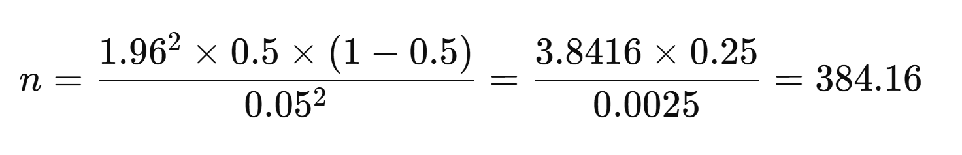
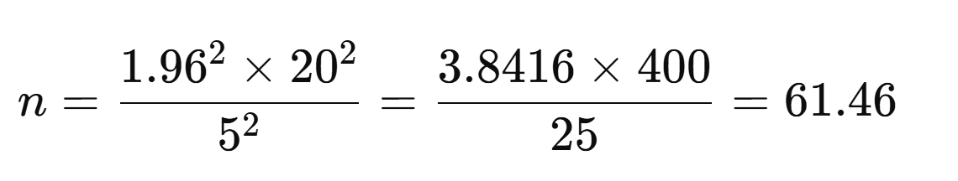
Example
Proportion
Continuous Variable
For a 95% confidence level, a margin of error of 5%, and an estimated proportion of 0.5:
So, approximately 385 participants are needed for this level of accuracy.
For a 95% confidence level, a margin of error of 5 units, and an estimated standard deviation of 20:
So, approximately 62 participants are needed.

Slide 24
Summary sample size calculation
Higher Confidence Level: Increases sample size.
Smaller Margin of Error: Increases sample size.
Higher Variability (Proportion close to 0.5 or higher standard deviation): Increases sample size.
Using these steps ensures that you calculate an adequate sample size to achieve the desired measurement accuracy for your study.
Using Sample Size Calculators - Tools such as G*Power, Raosoft, or online sample size calculators can help determine the sample size based on desired power, effect size, and confidence level.

Slide 25
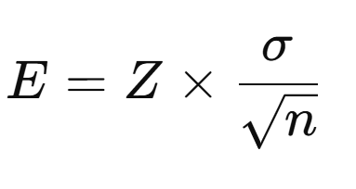
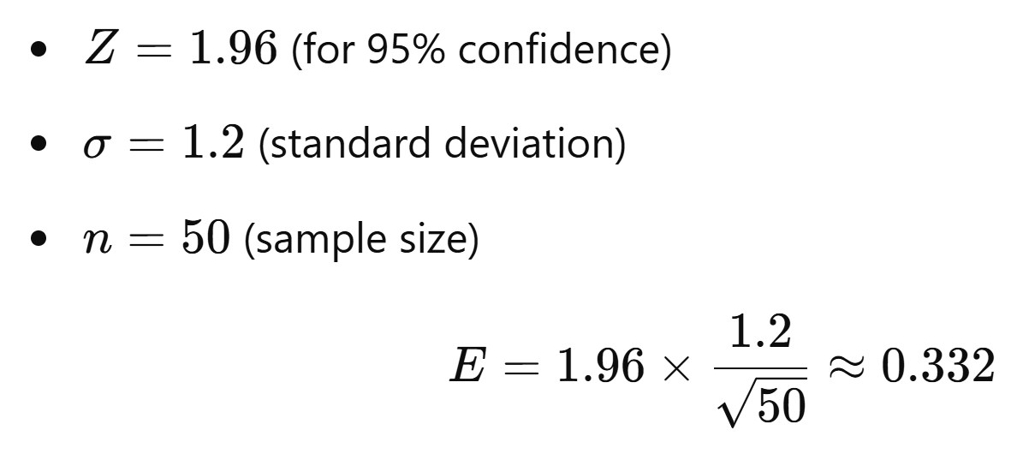
Estimating population parameters from sample statistics
There are two types of estimates you can make about the population:
  point estimate, a single value estimate of a parameter. For instance, a sample mean is a point estimate of a population mean.
  Example: Suppose you conduct a usability test with a sample of 50 users to determine the average task completion time for a new feature.
  Collect Data: After testing, you calculate that the mean task completion time for the 50 users is 4.5 minutes.
  Point Estimate: The sample mean (4.5 minutes) is your point estimate for the population mean—i.e., the average task completion time for all potential users of the feature.
  In this case, 4.5 minutes is the point estimate of the population mean task completion time based on your sample. This single value provides a straightforward, though approximate, answer for the average time users take to complete the task.
  interval estimate, that gives you a range of values where the parameter is expected to lie. A confidence interval is the most common type of interval estimate.
  In the above example lets say that the standard deviation is 1.2 minutes.
  Set the Confidence Level: You choose a 95% confidence level, which corresponds
  to a Z-score of 1.96.Calculate the Margin of Error (E):
  Construct the Confidence Interval:
    Lower bound = sample mean - E = 4.5 - 0.332 = 4.168 minutes
    Upper bound = sample mean + E = 4.5 + 0.332 = 4.832 minutes
  So, the 95% confidence interval for the average task completion time is 4.168 to 4.832 minutes.
Both types of estimates are important for gathering a clear idea of where a parameter is likely to lie.

Slide 26
Why all this is important?
The relationship between probability distribution and sample size is essential in understanding how well sample data represents the population and affects the accuracy of statistical estimates.
The Central Limit Theorem states that as the sample size increases, the sampling distribution of the sample mean (or sum) approaches a normal distribution (bell-shaped), regardless of the population's distribution shape (as long as it has a finite mean and variance).
As sample size increases, the variability (standard deviation) of the sampling distribution decreases. Larger sample sizes make the sampling distribution narrower, leading to more accurate and precise estimates of the population parameter.
A larger sample size leads to a smaller margin of error, making confidence intervals narrower. This gives a more precise estimate of the population parameter, as we are more certain of where the true value lies.
With a larger sample size, statistical tests become more powerful, meaning the probability of correctly rejecting a false null hypothesis increases.

Slide 27
Normality Characteristics of CLT
Normal Distributions are mainly defined by two parameters:
  the mean and
  the standard deviation

Slide 28
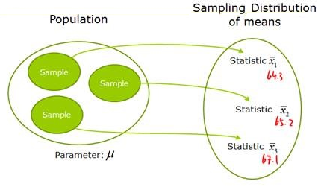
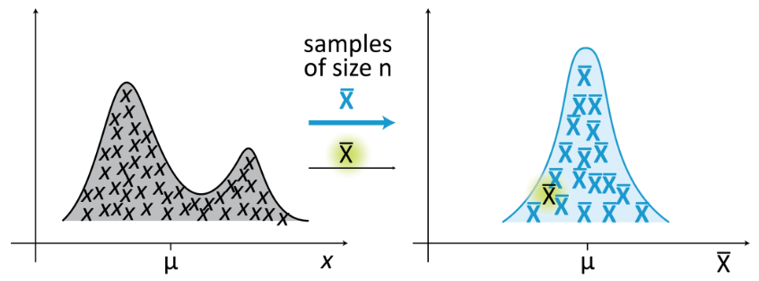




Central Limit Theorem (CLT)
1st normality characteristic
The Central Limit Theorem (CLT) is a fundamental concept in probability and statistics that determines the type of statistics we can conduct depending on the distribution of the sample
CLT: The mean of the sample means = mean of the population
  μ _{x̅} = μ
Population distribution
Sampling distribution of the means
Notes:
This means that I have to collect samples from all the population, which is not practical in reality

Slide 29
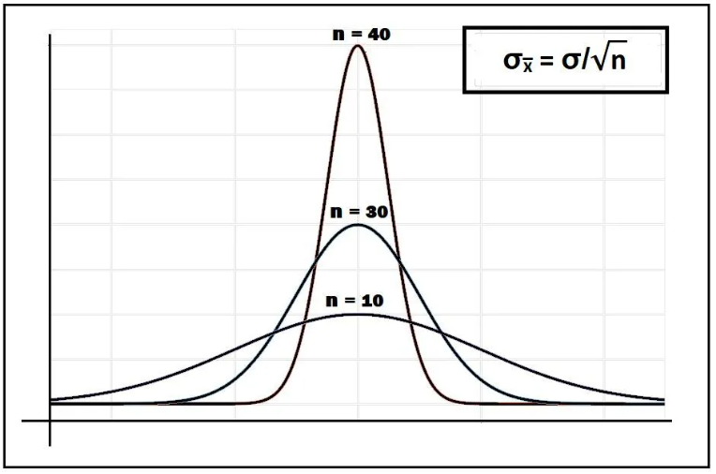
Central Limit Theorem (CLT)
2nd normality characteristic
CLT: The standard deviation of the sampling distribution of means (symbolically denoted by σx̅) is equal to σ/√n, where σ is the standard deviation of the population distribution and n is the sample size.
σx̅ = σ/√n
As we increase the sample size (n), the standard deviation of the sampling distribution of means (σx̅ = σ/√n) will become smaller, since we have the square root of the sample size in the denominator. In other words, the sampling distribution clusters more tightly around the mean as sample size increases.
Notes:
This means that I have to collect samples from all the population, which is not practical in reality

Slide 30
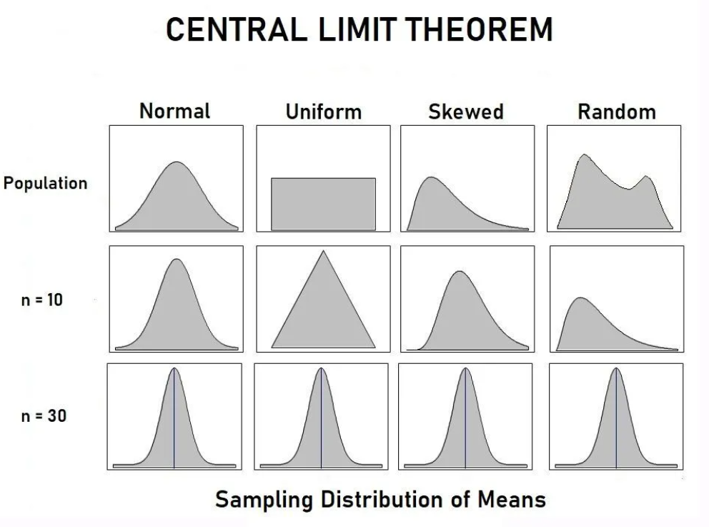
Central Limit Theorem (CLT)
3rd and 4th normality characteristics
CLT: If the population is normal, then the sample mean will have normal distribution (independent of sample size)
CLT: If the population is NOT normal but the sample size n > 30 then the sampling distribution of sample means approximates a Normal Distribution for any Population Distribution Shape
We can use the normal distribution z tables to calculate useful information
A sample of size 30 (i.e. n = 30) is considered large enough to see the effect and power of Central Limit theorem.
If the population is normal, then the theorem holds true even for samples smaller than 30
The distribution of sample means μ _{x̅}
is normal
Notes:
This means that I have to collect samples from all the population, which is not practical in reality

Slide 31
Application of CLT
Every distribution in some sense could become a normal distribution.
The Central Limit Theorem is a key concept in probability theory because it implies that probabilistic and statistical methods that work for normal distributions can be applicable to many problems involving multiple types of non-normal distributions.
If the distribution is not known or not normal, we consider the sample distribution to be normal according to CTL. This helps in analyzing data in methods like constructing confidence intervals.

Slide 32



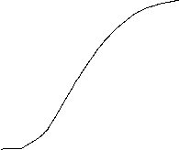



Exercise that applied CLT
The average time to complete a purchase using a website is 4.68 minutes. If the standard deviation is 1.5, find the probability that a random sample of 40 users finish between 4 and 5 minutes.
σ_{x̅} = σ/√n = 1.5 /√40 = 2.3717
x̅ - μ _{x̅}
z =
σ _{x̅}
μ _{x̅} = 4.68
σ = 1.5
x̅ - μ _{x̅}
z =
= (4-4.68) / 2.3717 = -2.87
σ _{x̅}
x̅ - μ _{x̅}
z
z =
= (5-4.68) / 2.3717 = 1.35
-3σ
-1σ
0
+σ
σ _{x̅}
+2σ
-2σ
+3σ
z
-2.87
1.35
Look up those values at the z normal table
4
5
x̅
0.18
1.68
3.18
4.68
6.18
7.68
9.18
0.91149 - 0.00205 = 0.90944
The probability of users completing a purchase within 4-5 minutes is 90.94%
1.35 = 0.91149
-2.87 = 0.00205

Slide 33
What is statistical significance?
An experiment begins with a null hypothesis, which states that there is no relationship between the two phenomena for which data will be collected.
We conduct the experiment to collect data to demonstrate if there is some type of relationship or effect. If there is the null hypothesis is rejected.
If a result is statistically significant, that means it’s unlikely to be explained solely by chance or random factors. In other words, a statistically significant result has a very low chance of occurring if there were no true effect in a research study.
A result that is statistically significant is based on a predetermined probability threshold that indicates that we should reject the null hypothesis; in other words, something did happen—a relationship was observed, an effect was produced, an association exists—and therefore the experiment has revealed something that is potentially meaningful or interesting.
Notes:
An experiment begins with a null hypothesis, which states that there is no relationship between the two phenomena for which data will be collected. If the objective of the experiment is to find or demonstrate some type of relationship or effect, the null hypothesis is tantamount to saying that the experiment will “fail.”
Statistical significance is a mathematical criterion that we can use to decide whether we should accept or reject the null hypothesis.
A result that is statistically significant based on a predetermined probability threshold indicates that we should reject the null hypothesis; in other words, something did happen—a relationship was observed, an effect was produced, an association exists—and therefore the experiment has revealed something that is potentially meaningful or interesting.
Phenomena governed by random processes usually produce a normal distribution of values. Thus, it is common practice to represent a conceptual null hypothesis as a Gaussian curve, meaning that this is the distribution of observations that we expect when one experimental variable is not affected by the other experimental variable.

Slide 34
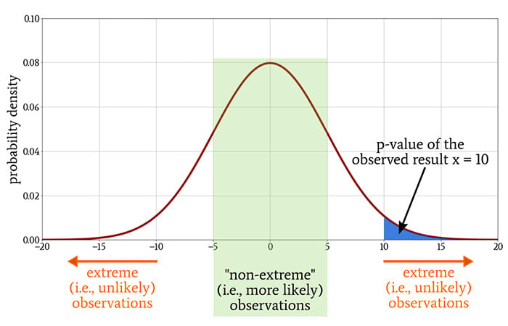





Probability threshold
Let’s say that through our experiment we obtained the number x (this could be anything—an average test completion time, number of errors).
By referring to the probability density function associated with the null hypothesis, we can determine whether the probability of obtaining x, or some other number that is more unlikely than x. The p-value conveys the probability of obtaining a result that is equal to or more extreme than the observed result when there is no relationship between the variables of interest.
If the p-value is sufficiently low, it doesn’t make sense to continue assuming that no relationship exists between the two variables. Thus, we reject the null hypothesis and claim that a relationship exists.
f(x)
P(a) ≤ x ≥ P(b)
P(a)
P(b)
a
b

Slide 35
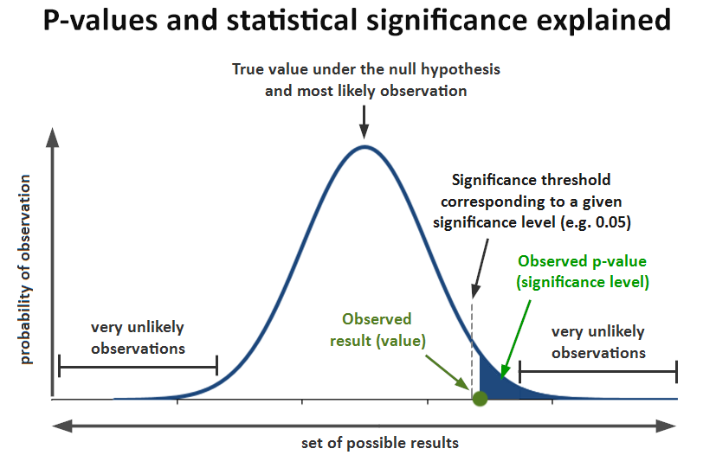
p-value
To establish statistical significance, we compare the p-value to the significance level, denoted by ⍺.
The p-value is less than or equal to alpha p ≤ α (threshold)
  We reject the null hypothesis. When this happens, we say that the result is statistically significant. In other words, we are reasonably sure that there is something besides chance alone that gave us an observed sample.
The p-value is greater than alpha p ≥ α
We fail to reject the null hypothesis. When this happens, we say that the result is not statistically significant. In other words, we are reasonably sure that our observed data can be explained by chance alone.

Slide 36

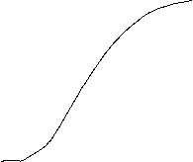




p value example
The p value, or probability value, tells you the statistical significance of a finding.
If p≤α => reject the H₀
If p>α => fail to reject the H₀
The level of significance/
level of confidence derives by
SL or CL = 1-α
e.g. if p=0.12
CL=1 - 0.12 = 0.88 CL is 88%
The area α depicts the level of significance/
level of confidence to reject the H₀
α
0
z_{L}
z
z_{data} => p > α
z_{data} => p ≤ α

Slide 37
Significance level
The most common threshold is p < 0.05, which means, there is a 5% probability that the result happened by chance and a 95% probability that it has been caused by the conditions of our experiment.
But this threshold can also be set higher or lower. Significance levels are somewhat arbitrary and are selected according to the conventions of a given field.
alpha ≤ 1% highly significant (h.s.)
alpha ≤ 5% significant (s.)
alpha > 5% not significant (n.s.)

Slide 38
Type I, II error
Significance testing is a process in which a null hypothesis is contrasted with the alternative hypothesis to determine the likelihood that the null hypothesis is true
A Type I error (also called α error or false positive) refers to the mistake of rejecting the null hypothesis when it is true and should not be rejected
A Type II error (also called β error or false negative) refers to the mistake of not rejecting the null hypothesis when it is false and should be rejected
 | Study conclusion: No Difference | Study conclusion: There is difference
Reality: No difference | No error | Type I error
Reality: There is difference | Type II error | No error

Slide 39
Comparing the means
Comparing means in usability testing involves analysing and comparing average performance metrics between different conditions or design variations.
Usability testing aims to assess how easily users can accomplish specific tasks and identify areas for improvement in the user interface or interaction design.
To compare means in usability testing we follow the steps below:
Define Usability Metrics
Determine Test Conditions
Recruit Participants
Conduct Usability Tests
Collect Data
Perform Statistical Analysis
Interpret Results
Iterate and Improve

Slide 40

Hypothesis testing process
Hypothesis testing is a formal procedure for investigating our ideas about the world using statistics. It is most often used by scientists to test specific predictions, called hypotheses, that arise from theories.
Write the hypotheses and plan the research design
Step 2
Step 1
Step 3
Step 4
Step 5
Collect data from a sample
Clean the data, organise the data and summarise the data with descriptive statistics
Choose a statistical test to evaluate the hypothesis or make estimates with inferential statistics
Interpret the results

Slide 41
Types of hypothesis
Step 1
Form the hypothesis
Types of hypothesis
Difference & correlation | Directed & undirected
Is there a difference between groups | Is there a difference or a correlation
Is there a correlation between groups | Is there a difference or a correlation in a certain direction

Slide 42
Types of hypothesis
Step 1
Form the hypothesis
Difference hypotheses
Correlation hypotheses
Check if there is a significant difference between two or more groups or conditions in a research study
Is there a difference between groups
There is a difference in data entry time between men and women
There is a difference in the data entry speed between the group that used the x-brand Ergonomic Keyboard, or the z-brand Ergonomic Keyboard
There is a categorical variable, e.g. gender (male, female), use of keyboard and at least an ordinal scaled variable, e.g. data entry speed
Is there a relationship or correlation between at least two variables?
There is a relationship between practice time entering data and data entry speed
There is a relationship between the use of the x-brand Ergonomic Keyboard and data entry speed
Correlation hypotheses often take the form “The more…, the higher/lower…”

Slide 43
Types of hypothesis
Step 1
Form the hypothesis
Undirected hypotheses (two-tailed)
Directed hypotheses (one-tail)
It involves making a statement about the possible difference or relationship between groups or conditions without specifying the direction of the effect
Is there a difference between groups
There is a difference in data entry time between men and women
There is a relationship between the used of an Ergonomic Keyboard and data entry time
Is a type of hypothesis where the researcher specifies the direction of the expected effect. Unlike an undirected or two-tailed hypothesis, a directed hypothesis predicts the outcome to be either greater than (or equal to) or less than (or equal to), but not both.
Women data entry time is higher then men
The more practice time entering data the higher the data entry speed

Slide 44
Null & Alternative hypothesis
Step 1
Form the hypothesis
 | Null hypotheses (H₀) | Alternative hypotheses (H_{a})
Definition | A claim that there is no effect in the population. | A claim that there is an effect in the population.
Also known as | H₀ | H_{a} H₁
Typical phrases used | No effect No difference No relationship No change Does not increase Does not decrease | An effect A difference A relationship A change Increases Decreases
Symbols used | Equality symbol (=, ≥, or ≤) | Inequality symbol (≠, <, or >)
H₀: There is no difference in data entry time between men and women.
H_{a}: There is a difference in data entry time between men and women.
  H₀: μ_{men} = μ_{women or} H₀: μ_{men} – μ_{women = 0}
  H_{a}: μ_{men} ≠ μ_{women}
Difference
H₀: There is no relationship between date entry practice time and data entry speed
H_{a}: There is a relationship between date entry practice time and data entry speed
The mathematical expression for the null hypothesis comparing the correlation between two variables, X and Y, would be:
Η₀: ρ_{XY}​=0
Correlation

Slide 45
Null & Alternative hypothesis
Step 1
Form the hypothesis
 | Null hypotheses (H₀) | Alternative hypotheses (H_{a})
Definition | A claim that there is no effect in the population. | A claim that there is an effect in the population.
Also known as | H₀ | H_{a} H₁
Typical phrases used | No effect No difference No relationship No change Does not increase Does not decrease | An effect A difference A relationship A change Increases Decreases
Symbols used | Equality symbol (=, ≥, or ≤) | Inequality symbol (≠, <, or >)
H₀: There is no difference in data entry time between men and women.
H_{a}: There is a difference in data entry time between men and women.
  H₀: μ_{women} = μ_{men or} H₀: μ_{women} – μ_{men = 0}
  H_{a}: μ_{women} ≠ μ_{men}
Undirected
H₀: Women have the same or longer data entry time compared to men.
H_{a}: Women data entry time is higher than men
  H₀: μ_{women} = μ_{men}
  H_{a}: μ_{women} > μ_{men}
Directed

Slide 46
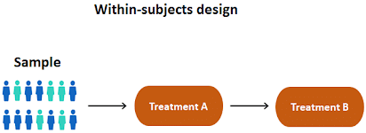
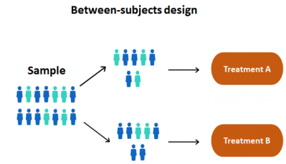
Experimental design
Step 1
Plan the research design
Week 4
There is a variety of statistical tests available, but they are all based on the comparison of within-group variance (how spread out the data is within a category) versus between-group variance (how different the categories are from one another).
Your choice of statistical test will be based on the type of data you collected.
If there is high within-group variance and low between-group variance, then the statistical test will reflect that with a high p-value. This means it is likely that any difference you measure between groups is due to chance.

Slide 47
Material prep
Step 2
Collect data
Week 5
Research instruments to collect the data
Conduct the study
For a statistical test to be valid, it is important to perform sampling and collect data in a way that is designed to test your hypothesis.
You need representative data, then you cannot make statistical inferences about the population.
To test differences in average data entry speed between men and women, your sample should have an equal proportion of men and women, and cover a variety of socio-economic classes and any other control variables that might influence average speed.
You should also consider your scope (Worldwide? For one country?) You need a potential data source that includes a variety of regions and social classes and is available for many countries around the world.

Slide 48
Clean data
Step 3
Clean & organise the data
Week 7
After data collection we to screen the data for possible errors.
Sometimes you can identify errors by conducting a reasonableness check. For instance, if the age of a participant is entered as “223,” you can easily conclude that there is something wrong.
Check various data entries e.g. age and years of experience

Slide 49
Data coding
Step 3
Clean & organise the data
Sample Demographic Data in Its Original Form
blank cell | Age | Gender | Highest Degree | Previous Experience In Software A
Participant 1 | 34 | Male | College | Yes
Participant 2 | 28 | Female | Graduate | No
Participant 3 | 21 | Female | High school | No
Week 7
Sample Demographic Data in Coded Form
blank cell | Age | Gender | Highest Degree | Previous Experience In Software A
Participant 1 | 34 | 1 | 2 | 1
Participant 2 | 28 | 0 | 3 | 0
Participant 3 | 21 | 0 | 1 | 0

Slide 50
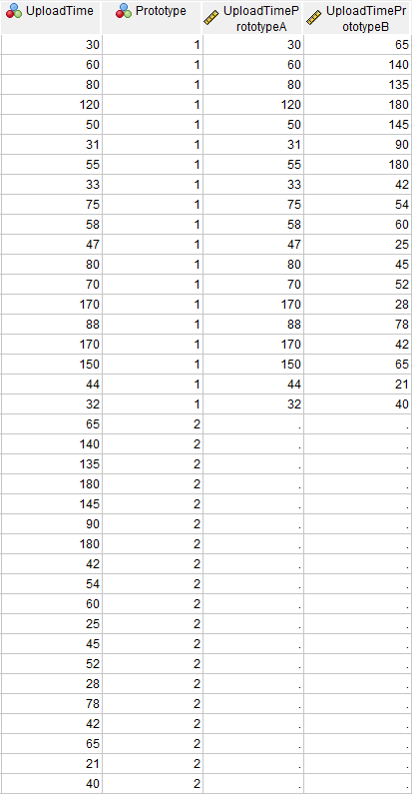
Organising the data
Week 7
Step 3
Clean & organise the data
Statistical and other data-processing software normally have predefined requirements for how data should be laid out for specific statistical analysis.
Data organization to compare two groups of data in SPSS and PSPP
Test
independent-samples t test | data of the two groups need to be listed in the same column
paired-samples t test | data of the two groups of need to be laid out parallel to each other in two separate columns

Slide 51
What test to use?
Step 4
Choose the statistical test
What statistical test to use depends on:
  Data type
  Sample size
  Data distribution
  Experimental design
  Hypothesis

Slide 52
Parametric vs Nonparametric statistics
Statistical tests rely of statistical fundamentals including: random variables, probability distributions, parameters, population, sample, sampling distributions and the Central Limit Theorem
Parametric statistics are based on assumptions about the shape of the distribution (i.e., assume a normal distribution) in the underlying population and about the form or parameters (i.e., means and standard deviations) of the assumed distribution.
Nonparametric statistics rely on no or few assumptions about the shape or parameters of the population distribution from which the sample was drawn. That is, the data can be collected from a sample that does not follow a specific distribution.

Slide 53

Types of statistical test
Step 4
Choose the statistical test
Data | Test type | Sample size | Data distribution | Variance | Outliers | Statistical tests
Interval Scale without a fundamental zero | Parametric statistical test | Large sample | data is normally distributed | Equal variances | No Outliers | z-Tests
 |  |  |  |  |  | t-Tests
Ratio Scale with a fundamental zero
 |  |  |  |  |  | ANOVA
Nominal categorical | Non parametric statistical test | Small sample | data is NOT normally distributed | Unequal variances | Outlies | Chi-square Test
Ordinal Rank or order

Slide 54
Commonly used test in usability testing
Step 4
Choose the statistical test
Commonly Used Significance Tests for Comparing Means and Their Application Context
Experiment Design | Independent Variables (IV) | Conditions for each IV | Types of Test
Between-group | 1 | 2 | Independent-samples t test
 | 1 | 3 or more | One-way ANOVA
 | 2 or more | 2 or more | Factorial ANOVA
Within-group | 1 | 2 | Paired-samples t test
 | 1 | 3 or more | Repeated measures ANOVA
 | 2 or more | 2 or more | Repeated measures ANOVA
Between- and within-group | 2 or more | 2 or more | Split-plot ANOVA

Slide 55
Result for hypothesis test
Step 5
Interpret the results
Is the null hypothesis retained or rejected?
If the p-value of an observed result is less than the predetermined threshold that we call the significance level, the observed result is very unlikely to occur if the null hypothesis is true. Therefore, we reject the null hypothesis, which is equivalent to affirming that the experiment has found a relationship between the variables of interest.
Reject the null hypothesis
set the significance level
calculate the p-value
p-value greater than specified significance level?
YES
NO
Keep the null hypothesis

Slide 56

Parametric tests
t-Tests
z-Tests
ANOVA
  One way ANOVA
  Factorial ANOVA
  Repeated ANOVA
  ANOVA for Split-Plot Design
Week 9

Slide 57
t-Test
The most widely adopted statistical procedure for comparing two means is the t-Test which compares the mean of two given samples. The mean and standard deviation are not known.
Different types of t-test should be adopted according to the specific design of the study:
  When the two groups being compared (between-group) are presumably unrelated, an independent-samples t-Test can be used
  When the two means are contributed by the same group (within-group), a paired-samples t-Test can be considered.
Rosenthal R, Rosnow R. (2008) Essentials of Behavioral Research: Methods and Data Analysis. third ed. Boston, MA: McGraw Hill.
Notes:
The null hypothesis often takes the form of a normal distribution, because that’s the distribution of values produced by so many phenomena that are influenced in random or extremely complex ways. However, when we actually need to calculate a p-value and report statistical significance, we very frequently use the t-distribution.
The t-distribution is similar to the normal distribution, and as sample size increases it gradually becomes identical to the normal distribution. The term “t-distribution” actually refers to a family of distribution curves, because the curve changes according to the experiment’s sample size.
More specifically, the exact shape of a t-distribution is determined by a parameter called degrees of freedom, denoted by νν (this is the lowercase Greek letter nu, not Latin v). Degrees of freedom is equal to the sample size (denoted by n) minus one:
ν=n−1ν=n−1
The following plots show the t-distribution for different values of νν, with the normal distribution included for comparison.

Slide 58
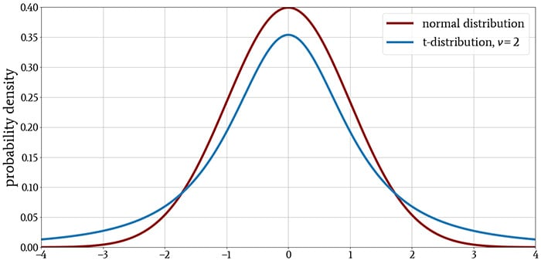
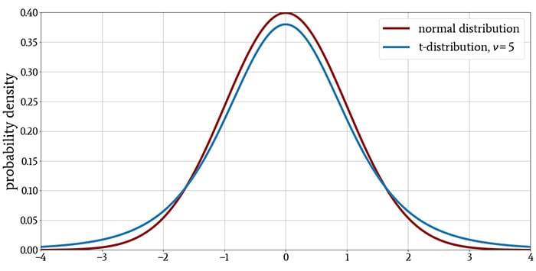
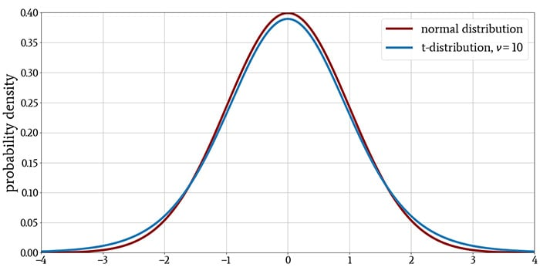
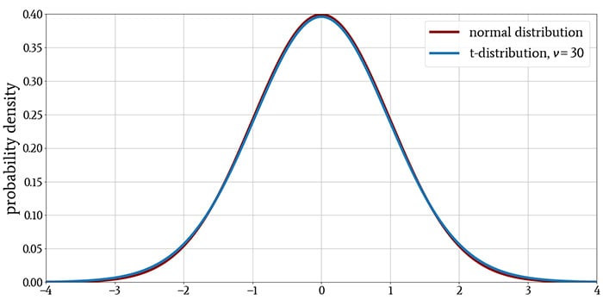
t-distribution for different values of ν
The t-distribution is similar to the normal distribution, and as sample size increases it gradually becomes identical to the normal distribution.
The exact shape of a t-distribution is determined by a parameter called degrees of freedom, denoted by ν. Degrees of freedom is equal to the sample size minus one:
  ν=n−1

Slide 59
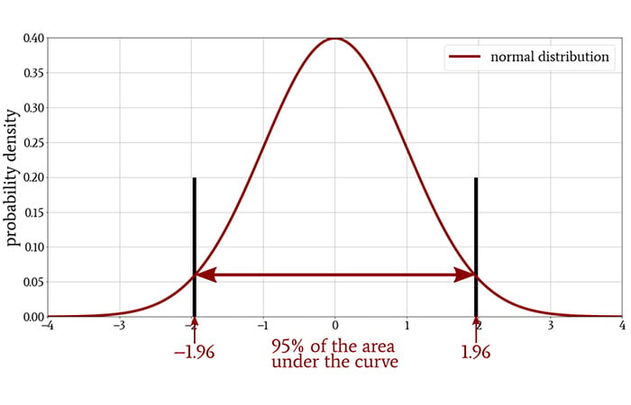
The origin of the t-Distribution
A concept that is closely related to statistical significance is the confidence interval.
Notes:
The Origin of the t-Distribution
A concept that is closely related to statistical significance is the confidence interval. The following diagram illustrates the two-sided 95% confidence interval of a standard normal distribution.
If the mean of a sample—that is, the mean of the measurements that we gathered during an experiment—falls within this confidence interval, the observed values are not statistically significant at a significance level of 5%. The sample mean must fall outside of the confidence interval in order to justify rejection of the null hypothesis.
The two values that define the confidence interval are called the critical values. In the case of a standard normal distribution, the critical values for a two-sided 95% confidence interval, which corresponds to a significance level of 5%, are –1.96 and +1.96. The critical values will change if we choose a different significance level.
It turns out that when the sample size in an experiment is small, the confidence interval will be too narrow if we model the null hypothesis as a normal distribution. This means that some observed values could fall outside the interval and therefore suggest statistical significance when in reality the experimental result is not statistically significant.
Why is the confidence interval too narrow when we use the normal distribution?
A full explanation would be too long for this article, but the problem boils down to the fact that we do not know the standard deviation of the population and must use the standard deviation of the sample instead. The standard deviation of a very small sample seriously underestimates the actual standard deviation, and we use the t-distribution to compensate for this effect.
As sample size increases, less compensation is required, and this is why the t-distribution more closely resembles the normal distribution when we have a larger sample size.
As you can see in the following plot, the 95% confidence interval becomes wider when we use the t-distribution instead of the normal distribution.
Conclusion
At this point, our discussion of the t-distribution is still quite theoretical. I hope that it has been theoretical in a good way, but in any event, future articles will help you to understand how we convert some of this theory into practice.

Slide 60
Example t-Test
Suppose you want to investigate whether the use of specific word-prediction software has an impact on typing speed.
The hypothesis of the test is: There is no significant difference in the task completion time between individuals who use the word-prediction software and those who do not use the software.
  H₀: x̄_{tc_word-prediction} - x̄_{no-tc_word-prediction} = 0
  H_{a}: x̄_{tc_word-prediction} - x̄_{no-tc_word-prediction} ≠ 0
What can be the experimental design?
 | SAMPLE | POPULATION
MEAN | x̄ | μ
St. Dev. | s | σ
 | STATISTIC | PARAMETER
1 | Recruit two groups of participants and have one group type some text using standard word-processing software only and another group using the word-processing software with word-prediction functions | Between group | Independent-Samples t Test
2 | Recruit one group of participants and have each participant complete comparable typing tasks under both conditions. | Within group | Paired-Samples t Test

Slide 61
Organise the data in SPSS/PSPP
  When the two groups being compared (between-group) are presumably unrelated
Sample Data for Independent-Samples t Test
Group | Participants | Task Completion Time | Coding
No prediction | Participant 1 | 245 | 0
No prediction | Participant 2 | 236 | 0
No prediction | Participant 3 | 321 | 0
No prediction | Participant 4 | 212 | 0
No prediction | Participant 5 | 267 | 0
No prediction | Participant 6 | 334 | 0
No prediction | Participant 7 | 287 | 0
No prediction | Participant 8 | 259 | 0
With prediction | Participant 9 | 246 | 1
With prediction | Participant 10 | 213 | 1
With prediction | Participant 11 | 265 | 1
With prediction | Participant 12 | 189 | 1
With prediction | Participant 13 | 201 | 1
With prediction | Participant 14 | 197 | 1
With prediction | Participant 15 | 289 | 1
With prediction | Participant 16 | 224 | 1
  The two means are contributed by the same group (within-group)
Sample Data for Paired-Samples t Test
Participants | No Prediction | With Prediction
Participant 1 | 245 | 246
Participant 2 | 236 | 213
Participant 3 | 321 | 265
Participant 4 | 212 | 189
Participant 5 | 267 | 201
Participant 6 | 334 | 197
Participant 7 | 287 | 289
Participant 8 | 259 | 224

Slide 62

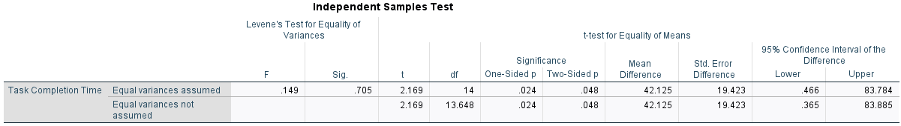
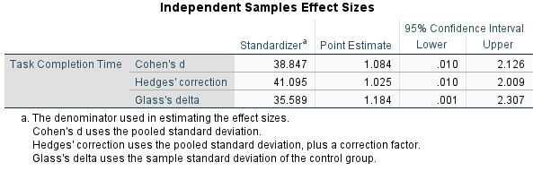
Results for independent sample t-Test
Sample Data for Independent-Samples t Test
Group | Participants | Task Completion Time | Coding
No prediction | Participant 1 | 245 | 0
No prediction | Participant 2 | 236 | 0
No prediction | Participant 3 | 321 | 0
No prediction | Participant 4 | 212 | 0
No prediction | Participant 5 | 267 | 0
No prediction | Participant 6 | 334 | 0
No prediction | Participant 7 | 287 | 0
No prediction | Participant 8 | 259 | 0
With prediction | Participant 9 | 246 | 1
With prediction | Participant 10 | 213 | 1
With prediction | Participant 11 | 265 | 1
With prediction | Participant 12 | 189 | 1
With prediction | Participant 13 | 201 | 1
With prediction | Participant 14 | 197 | 1
With prediction | Participant 15 | 289 | 1
With prediction | Participant 16 | 224 | 1
Compare the returned t value 2.169 with the normal t distribution table for the specific degree of freedom (df = 15) at the 95% confidence interval (see in the next slide that the value is t = 2.131)
t-test 2.169 > t distribution 2.131

Slide 63
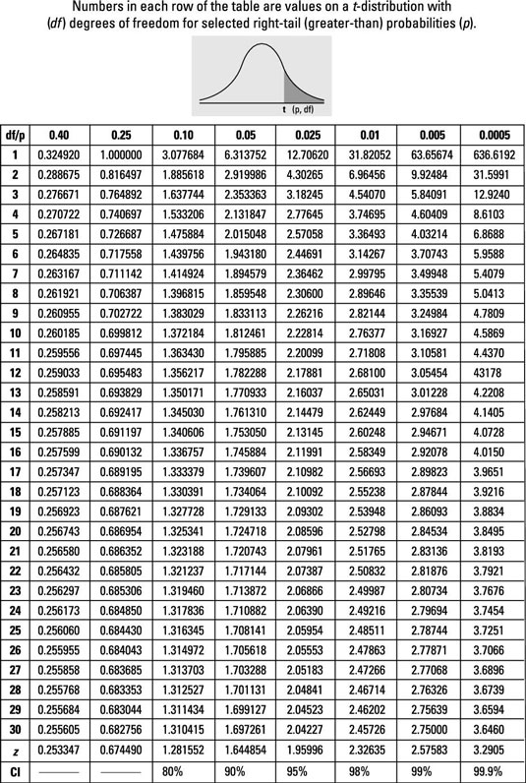

t-table
Degrees of freedom number of independent pieces of information used to calculate a statistic = n -1
n = sample
In this case 16 (participants) – 1 =15
(df = 15) at the 95% confidence interval (t = 2.131)
p(0.025)

Slide 64
Interpretation of t Test Results
The t-tests return a value, t, with larger t values suggesting a higher probability of the null hypothesis being false.
In other words, the higher the t value, the more likely the two means are different.
We normally use a 95% confidence interval in significance tests. So any t value that is higher than the corresponding t value at the 95% confidence interval suggests that there is a significant difference between participants (e.g., between users who use word-prediction software and those who do not).

Slide 65
Interpretation for independent sample t-Test
Sample Data for Independent-Samples t Test
Group | Participants | Task Completion Time | Coding
No prediction | Participant 1 | 245 | 0
No prediction | Participant 2 | 236 | 0
No prediction | Participant 3 | 321 | 0
No prediction | Participant 4 | 212 | 0
No prediction | Participant 5 | 267 | 0
No prediction | Participant 6 | 334 | 0
No prediction | Participant 7 | 287 | 0
No prediction | Participant 8 | 259 | 0
With prediction | Participant 9 | 246 | 1
With prediction | Participant 10 | 213 | 1
With prediction | Participant 11 | 265 | 1
With prediction | Participant 12 | 189 | 1
With prediction | Participant 13 | 201 | 1
With prediction | Participant 14 | 197 | 1
With prediction | Participant 15 | 289 | 1
With prediction | Participant 16 | 224 | 1
An independent-sample t test suggests that there is a significant difference in the task completion time between the group that used the standard word-processing software and the group that used word-processing software with word prediction functions (t(15) = 2.169, p (0.024) < 0.05)

Slide 66

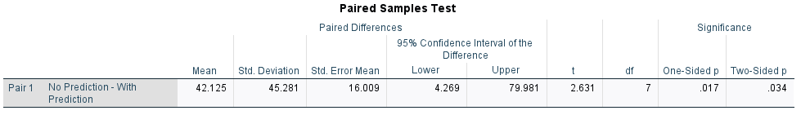
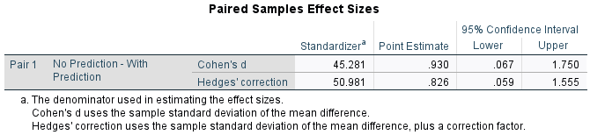
Results for Paired sample t-Test
Sample Data for Paired-Samples t Test
Participants | No Prediction | With Prediction
Participant 1 | 245 | 246
Participant 2 | 236 | 213
Participant 3 | 321 | 265
Participant 4 | 212 | 189
Participant 5 | 267 | 201
Participant 6 | 334 | 197
Participant 7 | 287 | 289
Participant 8 | 259 | 224
The returned t value is 2.631, which is higher than the t value for the specific degree of freedom (df = 7) at the 95% confidence interval (t = 2.364)

Slide 67
t-table
Degrees of freedom number of independent pieces of information used to calculate a statistic = n -1
n = sample
In this case 8 (participants) – 1 =7
(df = 7) at the 95% confidence interval (t = 2.364)
p(0.025)

Slide 68
Interpretation for Paired sample t-Test
Sample Data for Paired-Samples t Test
Participants | No Prediction | With Prediction
Participant 1 | 245 | 246
Participant 2 | 236 | 213
Participant 3 | 321 | 265
Participant 4 | 212 | 189
Participant 5 | 267 | 201
Participant 6 | 334 | 197
Participant 7 | 287 | 289
Participant 8 | 259 | 224
An paired-sample t test suggests that there is a significant difference in the task completion time between the group that used the standard word-processing software and the group that used word-processing software with word prediction functions (t(7) = 2.364, p (0.025) < 0.05)

Slide 69
Example t-Test
One-Tailed (Side) Test | Two-Tailed (Side) Test
For one-tailed, we use either > or < sign for the alternative hypothesis. | For two-tailed, we use ≠ sign for the alternative hypothesis.
When the alternative hypothesis specifies a direction then we use a one-tailed test. | If no direction is given then we will use a two-tailed test.
The critical region lies entirely on either the right side or left side of the sampling distribution. | The critical region is given by the portion of the area lying in both the tails of the probability curve of the test statistic.
The Entire level of significance (α) i.e. 5% has either in the left tail or right tail. | It splits the level of significance (α) into half.
Rejection region is either from the left side or right side of the sampling distribution. | Rejection region is from both sides i.e. left and right of the sampling distribution.
It checks the relation between the variable in a singles direction. | It checks the relation between the variables in any direction.
It is used to check whether the one mean is different from another mean or not. | It is used to check whether the two mean different from one another or not.
In some empirical studies, the hypothesis indicates the direction of the difference. For example, you may expect the use of word-prediction software to improve typing speed.
The hypothesis of the test is: Individuals who use word-prediction software can type faster than those who do not use word-prediction software
H₀: x̄_{tc_word-prediction} - x̄_{no-tc_word-prediction} = 0
H_{a}: x̄_{tc_word-prediction} < x̄ _{no-tc_word-prediction}

Slide 70
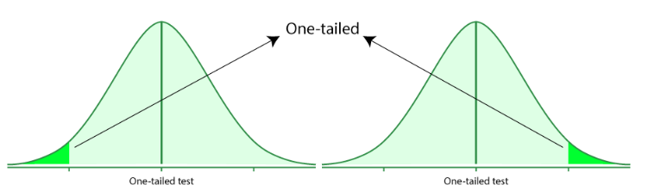
One-Tailed Test
A one-tailed test is based on a uni-directional hypothesis where the area of rejection is on only one side of the sampling distribution. It determines whether a particular population parameter is larger or smaller than the predefined parameter. It uses one single critical value to test the data.

Slide 71
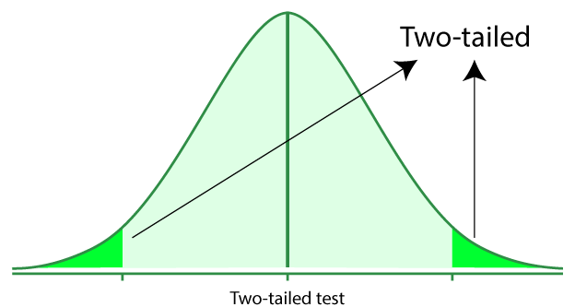
Two-Tailed Test
A two-tailed test is also called a nondirectional hypothesis. For checking whether the sample is greater or less than a range of values, we use the two-tailed. It is used for null hypothesis testing.

Slide 72
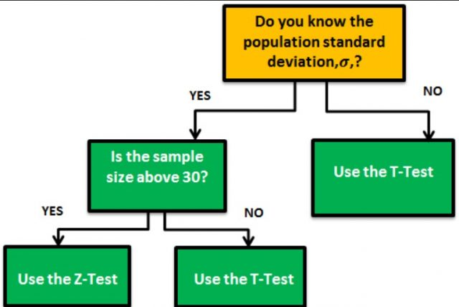
z-test
z-test is a statistical test used to determine whether two population means are different when the variances are known and the sample size is large.
In z-test mean of the population is compared. The parameters used are population mean and population standard deviation.
z-test is used to validate a hypothesis that the sample drawn belongs to the same population.
  H₀: Sample mean is same as the population mean(Null hypothesis)
  H_{a}: Sample mean is not same as the population mean(Alternate hypothesis)
  z = (x̄ — μ) / (σ / √n),
  where , x̄ =sample mean, μ=population mean, σ / √n = population standard deviation.
If- the z value is less than the critical value we accept the null hypothesis else we reject null hypothesis.

Slide 73
Summary
  Basic statistics concepts
    Probability
    Central Limit Theorem
    Significance
    Confidence interval
    P-value
  Hypothesis testing process
  Types of Hypothesis
  Parametric Tests t-Tests, z-Tests
  Next week we will cover ANOVAs and we will discuss non-parametric tests and correlations

Slide 74
Test your understanding
What is frequency distribution?
What is that information that a frequency table holds?
What type of frequency distributions you know?
What is probability distribution?
What is the range of numbers for a probability distribution?
Why we use inferential statistics?
Why sample size is important?
What is sampling error?
What is the importance of confidence interval?
What is the confidence level?
What are the normality characteristics of the Central Limit Theorem?
How we apply Central Limit Theorem?
What is statistical significance?
What is a probability threshold?
What is p value and how we use it in hypothesis testing?
What is Type Error I and Type Error II?
What are the main steps in hypothesis testing?
What are the main steps of hypothesis testing?
What types of hypotheses?
Form a null and alternative hypothesis for all the following types of hypotheses (work on the hypotheses you have to form for your coursework)
  Difference hypotheses
  Form a Correlation hypotheses
  Form an Undirected hypothesis (two-tailed)
  Form a directed hypothesis (one-tail)
Think of the experimental design you would follow for each of the hypothesis you have formed, which statistical test you can use to test the hypothesis you have formed?
Think of the variables you would have to create in SPSS to organise your data (work on your coursework)
How would you organise your data in SPSS (work on your coursework)
What is a parametric and a nonparametric test?
How would you use the alpha value and the p value to discuss the significance of your results?

Slide 75
Reading
Lazar, J. et al. (2017) Research methods in human-computer interaction. Second edition. Cambridge, Massachusetts: Morgan Kaufmann Publishers.
  Chapter 4. Statistical analysis
Online Resources
Turney, S. (2022, July 18). Frequency Distribution | Tables, Types & Examples. Scribbr. Retrieved November 6, 2022, from https://www.scribbr.com/statistics/frequency-distributions/
Turney, S. (2022, June 09). Probability Distribution | Formula, Types, & Examples. Scribbr. Retrieved November 6, 2022, from https://www.scribbr.com/statistics/probability-distributions/
Bhandari, P. (2022, July 06). Normal Distribution | Examples, Formulas, & Uses. Scribbr. Retrieved November 6, 2022, from https://www.scribbr.com/statistics/normal-distribution/
Bhandari, P. (2022, June 10). The Standard Normal Distribution | Examples, Explanations, Uses. Scribbr. Retrieved November 4, 2022, from https://www.scribbr.com/statistics/standard-normal-distribution/
Bhandari, P. (2022, July 06). Inferential Statistics | An Easy Introduction & Examples. Scribbr. Retrieved November 6, 2022, from https://www.scribbr.com/statistics/inferential-statistics/
Turney, S. (2023, June 22). Central Limit Theorem | Formula, Definition & Examples. Scribbr. Retrieved November 9, 2023, from https://www.scribbr.com/statistics/central-limit-theorem/
Bevans, R. (2022, July 09). Understanding Confidence Intervals | Easy Examples & Formulas. Scribbr. Retrieved November 5, 2022, from https://www.scribbr.com/statistics/confidence-interval/
Bevans, R. (2022, July 15). Hypothesis Testing | A Step-by-Step Guide with Easy Examples. Scribbr. Retrieved November 11, 2022, from https://www.scribbr.com/statistics/hypothesis-testing/
Bevans, R. (2022, July 09). An Introduction to T-Tests | Definitions, Formula and Examples. Scribbr. Retrieved November 13, 2022, from https://www.scribbr.com/statistics/t-test/
The p value – definition and interpretation of p-values in statistics
https://www.gigacalculator.com/articles/p-value-definition-and-interpretation-in-statistics/#pmeaning

